Slide 1
Building Malware Analysis & Threat Intelligence Pipeline using Cloud
-Abhinav Singh

Slide 2


About Me
Security researcher. Speaker at Blackhat, RSA, Defcon, etc.
Author– Metasploit Penetration testing Cookbook (1st, 2nd & 3rd Ed.)
Linkedin.com/in/abhinavbom/
Github.com/abhinavbom/
@abhinavbom
@MalwareMustDie!

Slide 3

Varanasi, India

Slide 4
Agenda
Why build your own platform?
Comparing traditional infrastructure with cloud service providers.
Defining the architecture.
Planning the initial phases of file processing.
First phase of static analysis.
Second phase of extracting detailed features from processed files.
Gluing the engines together.
Storing and processing the results.
Third phase: Visualization and threat intelligence dashboard using Kibana.
Future Work: UI, Machine Learning, Advance API services.

Slide 5
Disclaimer
This workshop isn’t about malware analysis or Threat Intelligence.

Slide 6

Question: Why build your own platform?
Lots of malware analysis and Threat Intelligence platforms available for free(more or less) online.
Range of commercially available platforms.
Security companies have their own dedicated labs and resources for their researchers and engineers.
Open source tools which can solve the problem in parts.

Slide 7
Answer:
Fine grained data is missing on online tools.
Commercial tools provide limited information about detections and alerts which limits the viewpoint of incident responders.
Several open source tools designed to solve specific problems of researchers and analysts.
Building your own tool makes you a better researcher and promotes a more critical thinking towards product development.
Less code, more throughput.
I travel a lot and I cant carry my servers everywhere.

Slide 8
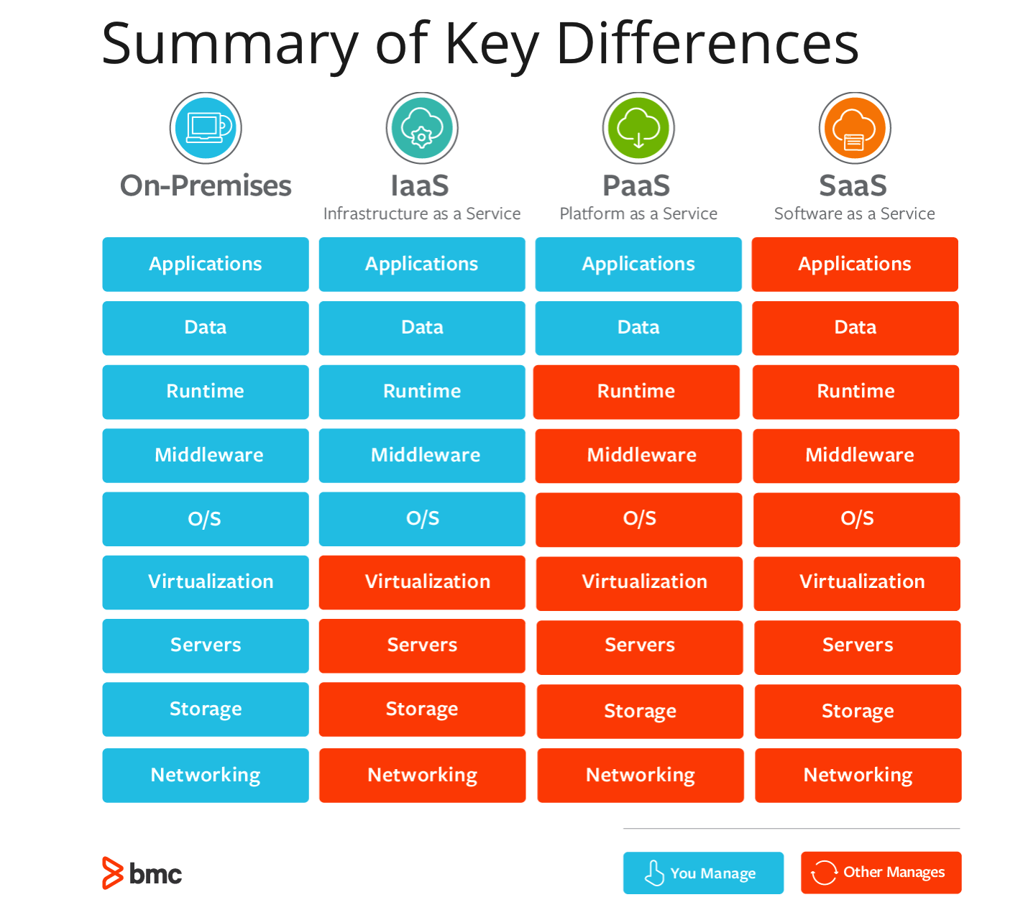
Comparing Traditional Infrastructure with Cloud Services

Slide 9
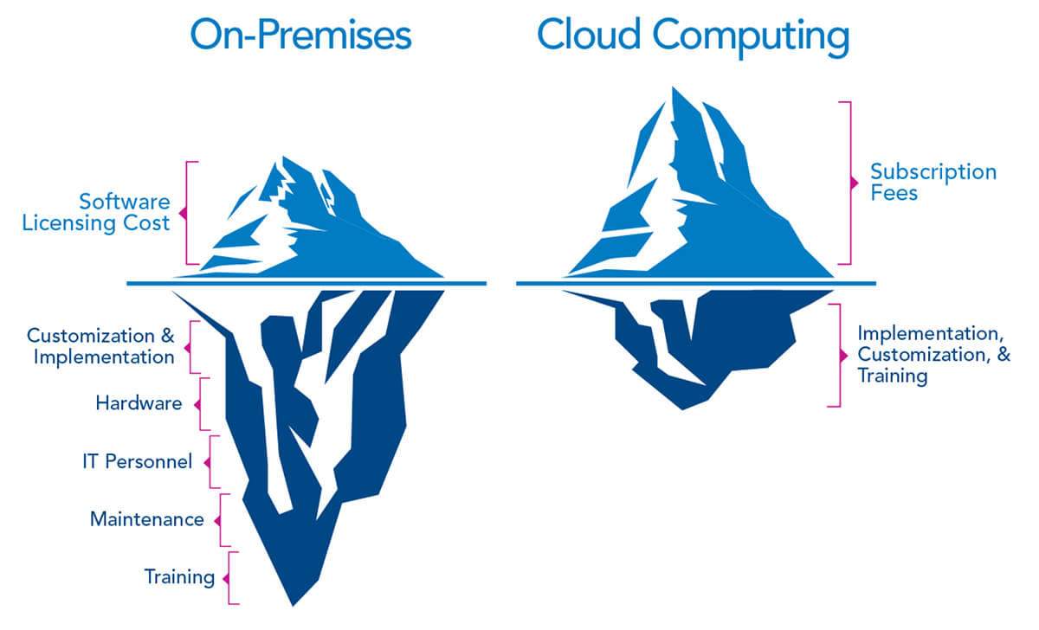

Slide 10
Defining The Architecture
Simple Malware analysis and intelligence gathering process.
Software architecture design.
Planning & Mapping with Cloud service provider.
Detailed architecture of our cloudmalscanner pipeline

Slide 11
Simple Malware Analysis & Intelligence Gathering Process
Static Analysis
Heuristic Analysis
Dynamic Analysis
Intelligence Collection & reporting

Slide 12
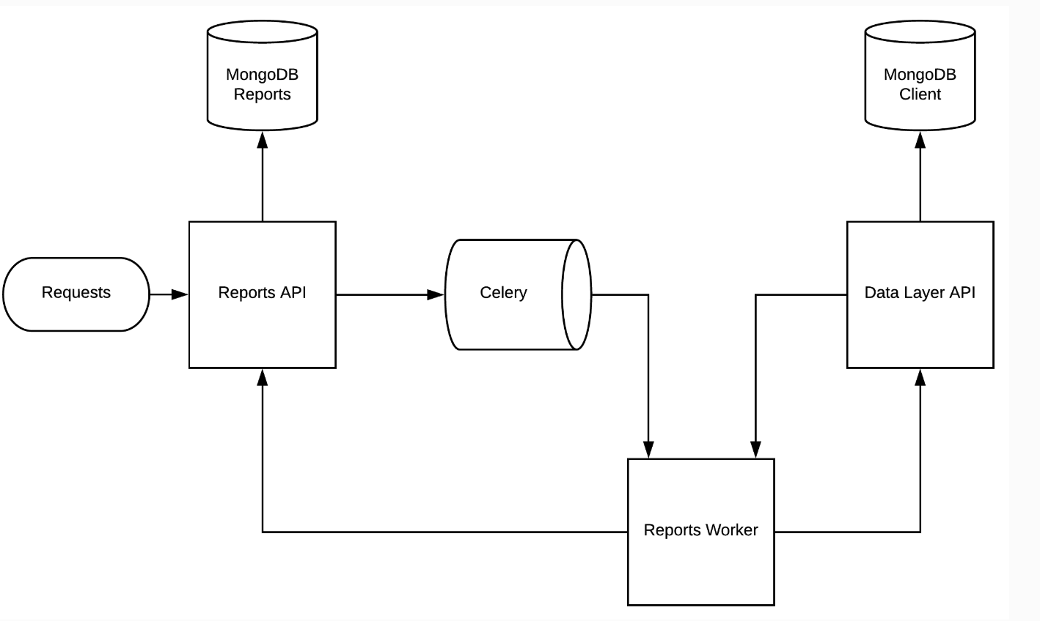
Software Architecture Design

Slide 13
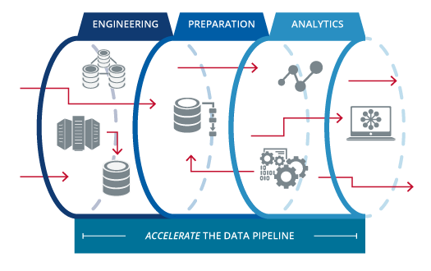
Planning our pipeline

Slide 14
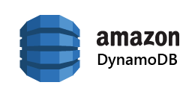



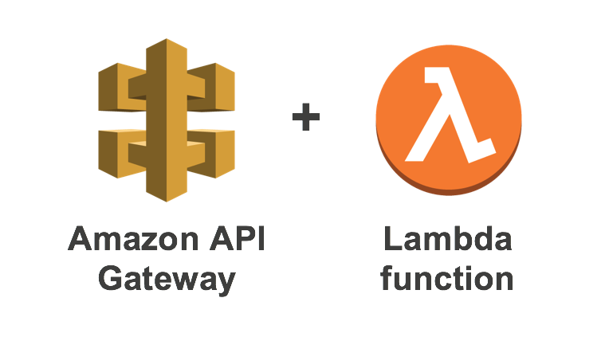
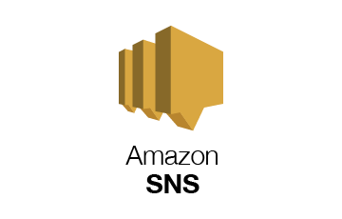
Mapping Cloud services with traditional infrastructure services

Slide 15




High level architecture of our pipeline
DB
Static AV & Yara Scan
Heuristic Scan
Sandbox Scan

Slide 16
What? Why ? Where?
What | Why | Where
File submission process | Mode by which our engine can receive the files | At the endpoint(s) where the files reside
Creating a local copy of files submitted | This is needed for retention and/or resubmission purpose. | S3 bucket
Static AV scanning | Quick way to determine bad files | Lambda functions.
Signature updates for AV scanning | Quick way to respond to new threats | S3 bucket
Heuristic feature extraction | Getting advance telemetry for threat intelligence | EC2 or Container instance
Sandbox Analysis | Getting runtime execution details about the sample for detection and intelligence | EC2
Alert generation | Incident response | SNS topics
Storing the result | Backup of data | DynamoDB/MongoDB/SQL DB
Dashboard | Visualization, analytics and Intelligence | Elasticsearch & Kibana

Slide 17
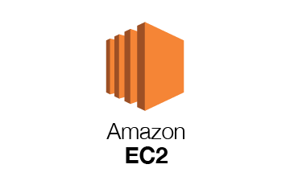






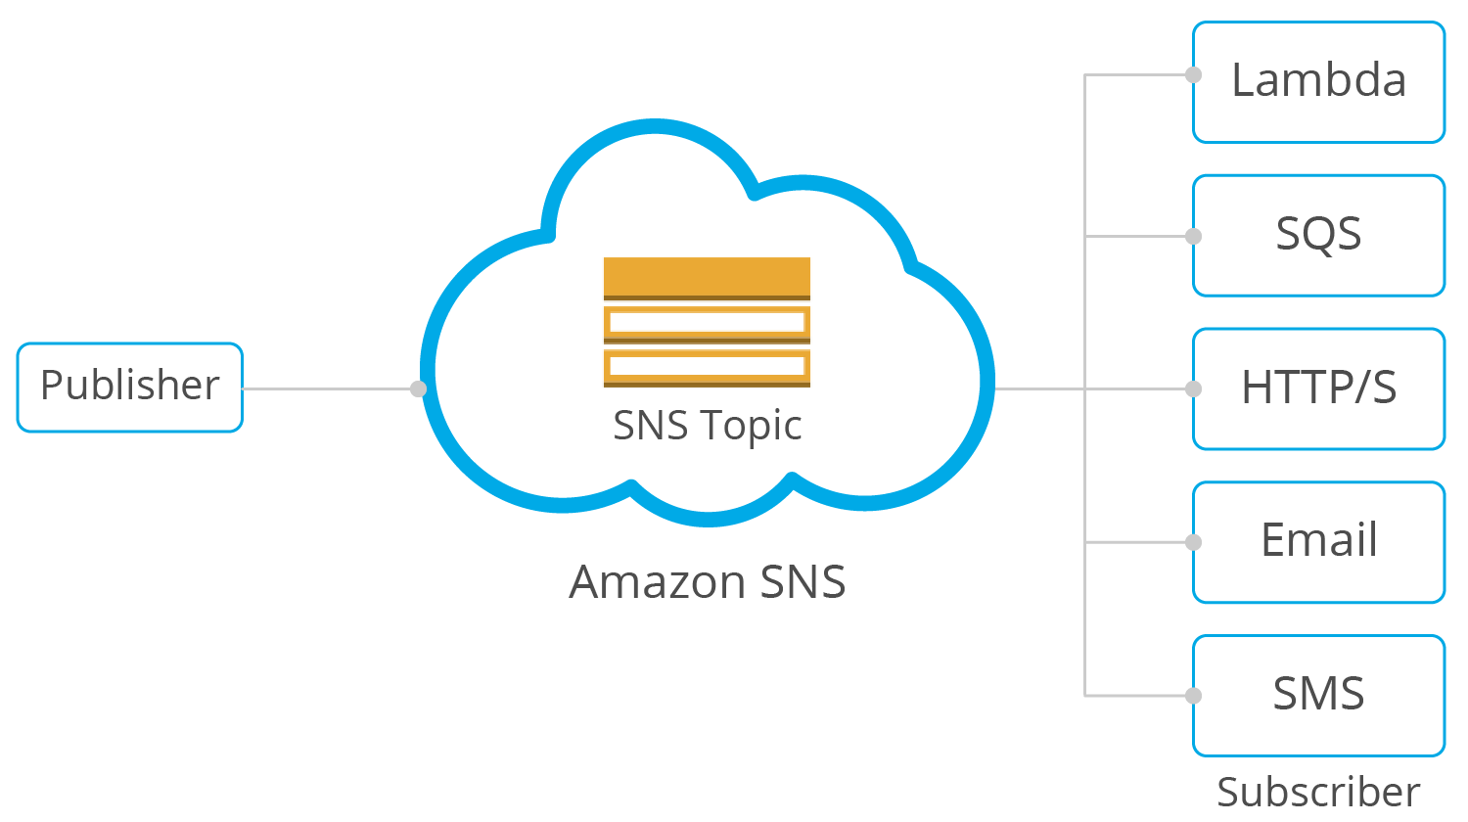




Planning the Architecture of Our Pipeline
VPC Group
Exe
Lambda Functions
Office
PDF
SWF
SQS Queue
ELF
Zip

Slide 18
What is AWS Lambda
AWS Lambda is a compute service that lets you run code without provisioning or managing servers.
AWS Lambda executes your code only when needed and scales automatically, from a few requests per day to thousands per second.
Runs your code in response to events.
https://docs.aws.amazon.com/lambda/latest/dg/python-programming-model.html
Notes:
def handler_name(event, context):
... return some_value
event – AWS Lambda uses this parameter to pass in event data to the handler. This parameter is usually of the Python dict type. It can also be list, str, int, float, or NoneType type.
context – AWS Lambda uses this parameter to provide runtime information to your handler.

Slide 19
First phase of Static Analysis
Using ClamAV and Yara rules.
Quick and efficient at catching commodity malware related files.
Would require a mechanism for definition updates.

Slide 20
Server-less static analysis Phase
File storage Bucket
2
1
ClamAV Scan
Yara Scan
5
3
4
Processing
Queue
ClamAV Definition
Update bucket
Yara Rules
update bucket
Notes:
Three ways for file upload:
using AWS cli
Using an ECS web app.
Directly uploading to the S3 bucket with SQS trigger in place
What are lambda functions?

Slide 21
Code Analysis & Demo
Github.com/abhinavbom/clara
Setting it up on AWS.

Slide 22
Planning the 2nd Phase – Advance Feature Extraction
Transferring control from Phase 1 lambda function to next phase feature extraction.
Exposing API to receive file and display result.
Running feature extraction modules in dedicated virtual machine.
Result storage and transfer to analytics services(3rd Phase).

Slide 23
What is feature extraction?
Involves reducing the number of resources required to describe a large set of data.
Static metadata of the file.
Parsable attributes of the file.

Slide 24
Static Feature Extraction from Files
Deciding on important file formats (EXE, PDF, OFFICE, ZIP).
Deciding on feature extraction engines:
EXE : Pefile, Pe-parse.
PDF: pdf-parser, Pypdf.
OFFICE: Oletools, Oledump.

Slide 25
Tool Demo
PDF
Office
Exe
Notes:
Pdf-parser.py –stats
Pdf-parser.py –search javascript

Slide 26
Take a Pause!!.. Revise!!.....Question!!
We have a static AV scan which quickly scans the files through set of pre-defined signatures.
Ideally we should be sending bulk of files through this engine which will then pass to our feature extractors.

Slide 27


Slide 28
Identifying the File-type
File-extension.
Unix Filetype.
Python Filetype, Python magic.
Where to implement
A new lambda function.
As a part of the feature extraction framework

Slide 29
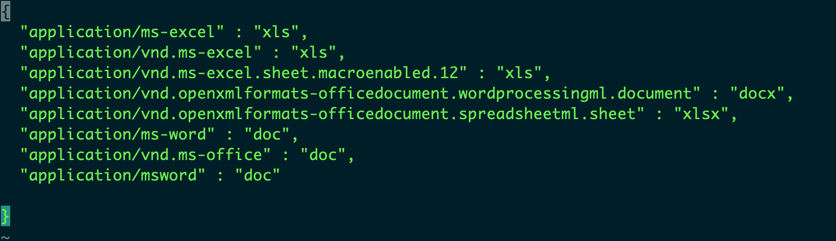
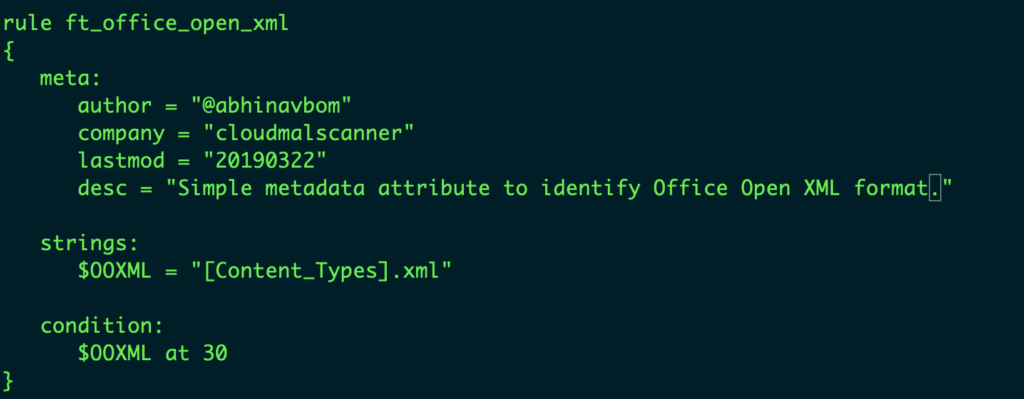
Example Of Filetype Identification
Config based.
Yara based.
Notes:
http://www.garykessler.net/library/file_sigs.html

Slide 30
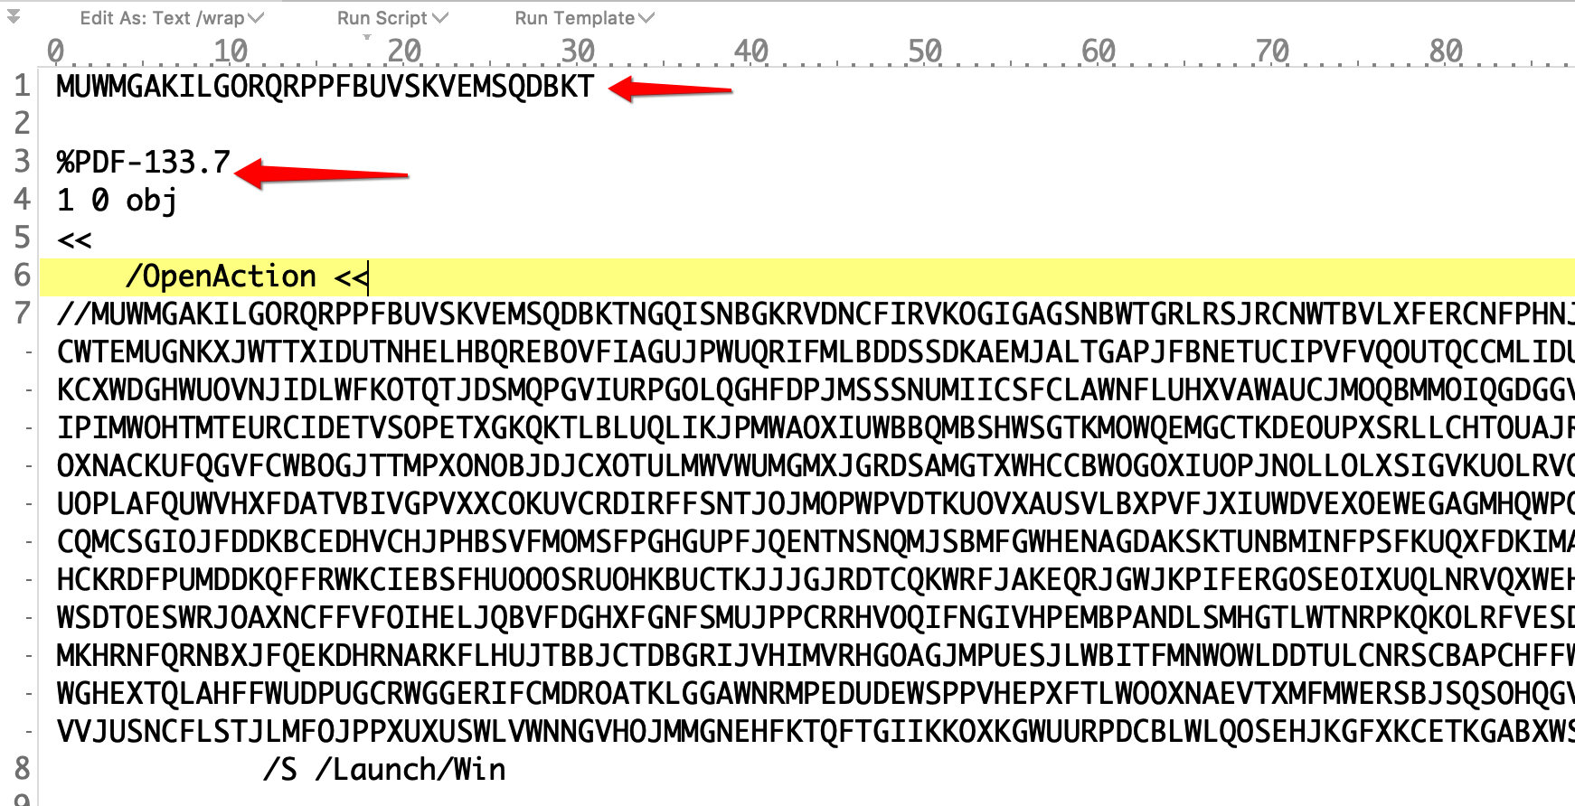
Note of Caution
Malwares evading Filetype determination.
Double extensions (you.are.fool)
Filetype specific evasions (portmanteau)
https://www.youtube.com/watch?v=ADlGlFGAdiY (Julia Wolf)
Notes:
/Desktop/corner-case/

Slide 31


Slide 32
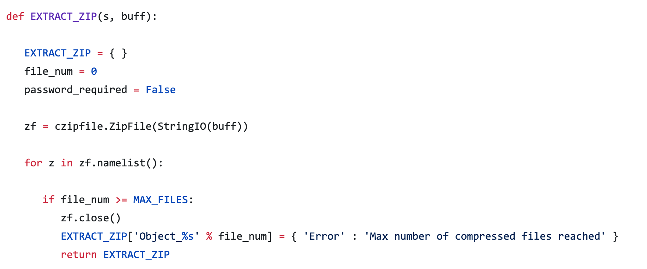
Handling Zip Files & Embedded Objects
Unzip and submit each individual file.
As an advance feature:
Allow unzipping of archive using common password schemes.

Slide 33

Is that it???
Notes:
Zipbomb.
Many Office filetypes are Zip too so make sure that such cases are handled correctly.
Some modules should run on all files like Hash lookup, VT lookup or your custom BL/WL lookup.

Slide 34
Virtual Server based Feature Extraction Phase (2nd Phase)
Incoming data from
Lambda functions

Slide 35
Filetype Based Modules
Mandatory Modules
Extract_PE
Flask App or Daemon
Hash Calculations
Extract_PDF
Filetype Determination
VT Lookup
Extract_OLE
Zip Extraction
Custom WL/BL Lookup
Extract_OOXML
Extract_SWF

Slide 36
Setting up your EC2 instance
Instance acts as the server receiving files for feature extraction.
Decide the configuration.
Adding it to auto-scaling group.

Slide 37
Code Analysis & Demo Examples
https://github.com/abhinavbom/fsf

Slide 38
Visualization, Analytics & Intelligence
Using the stored data for visualization.
Kibana Dashboards for analytics
KQL for intelligence search

Slide 39
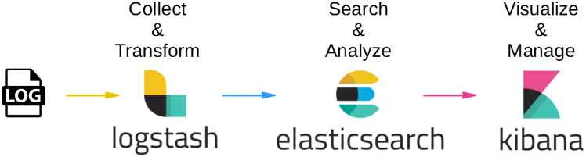
Visualization, Analytics & Intelligence

Slide 40
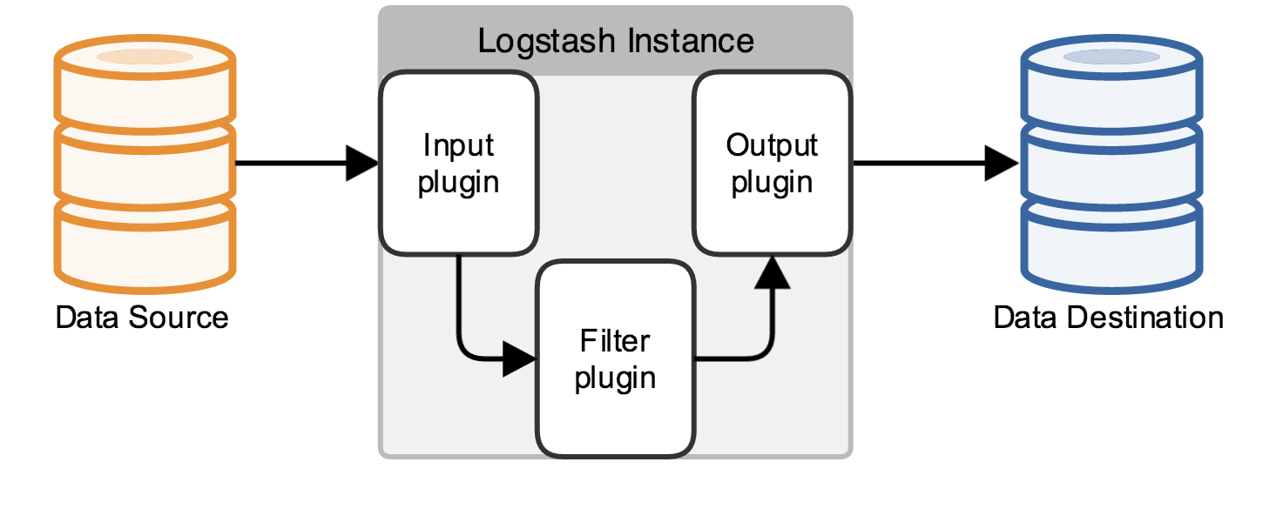
Setting up Logstash for Log ingestion & streaming
Install Logstash
Setup Json filter.
Pass Kibana instance URL to start streaming logs.
Invoke Logstash process

Slide 41
Kibana Dashboard Demo and Queries
Creating Queries to extract intelligence out of the data
Build Visualizations.
Create Dashboards.

Slide 42
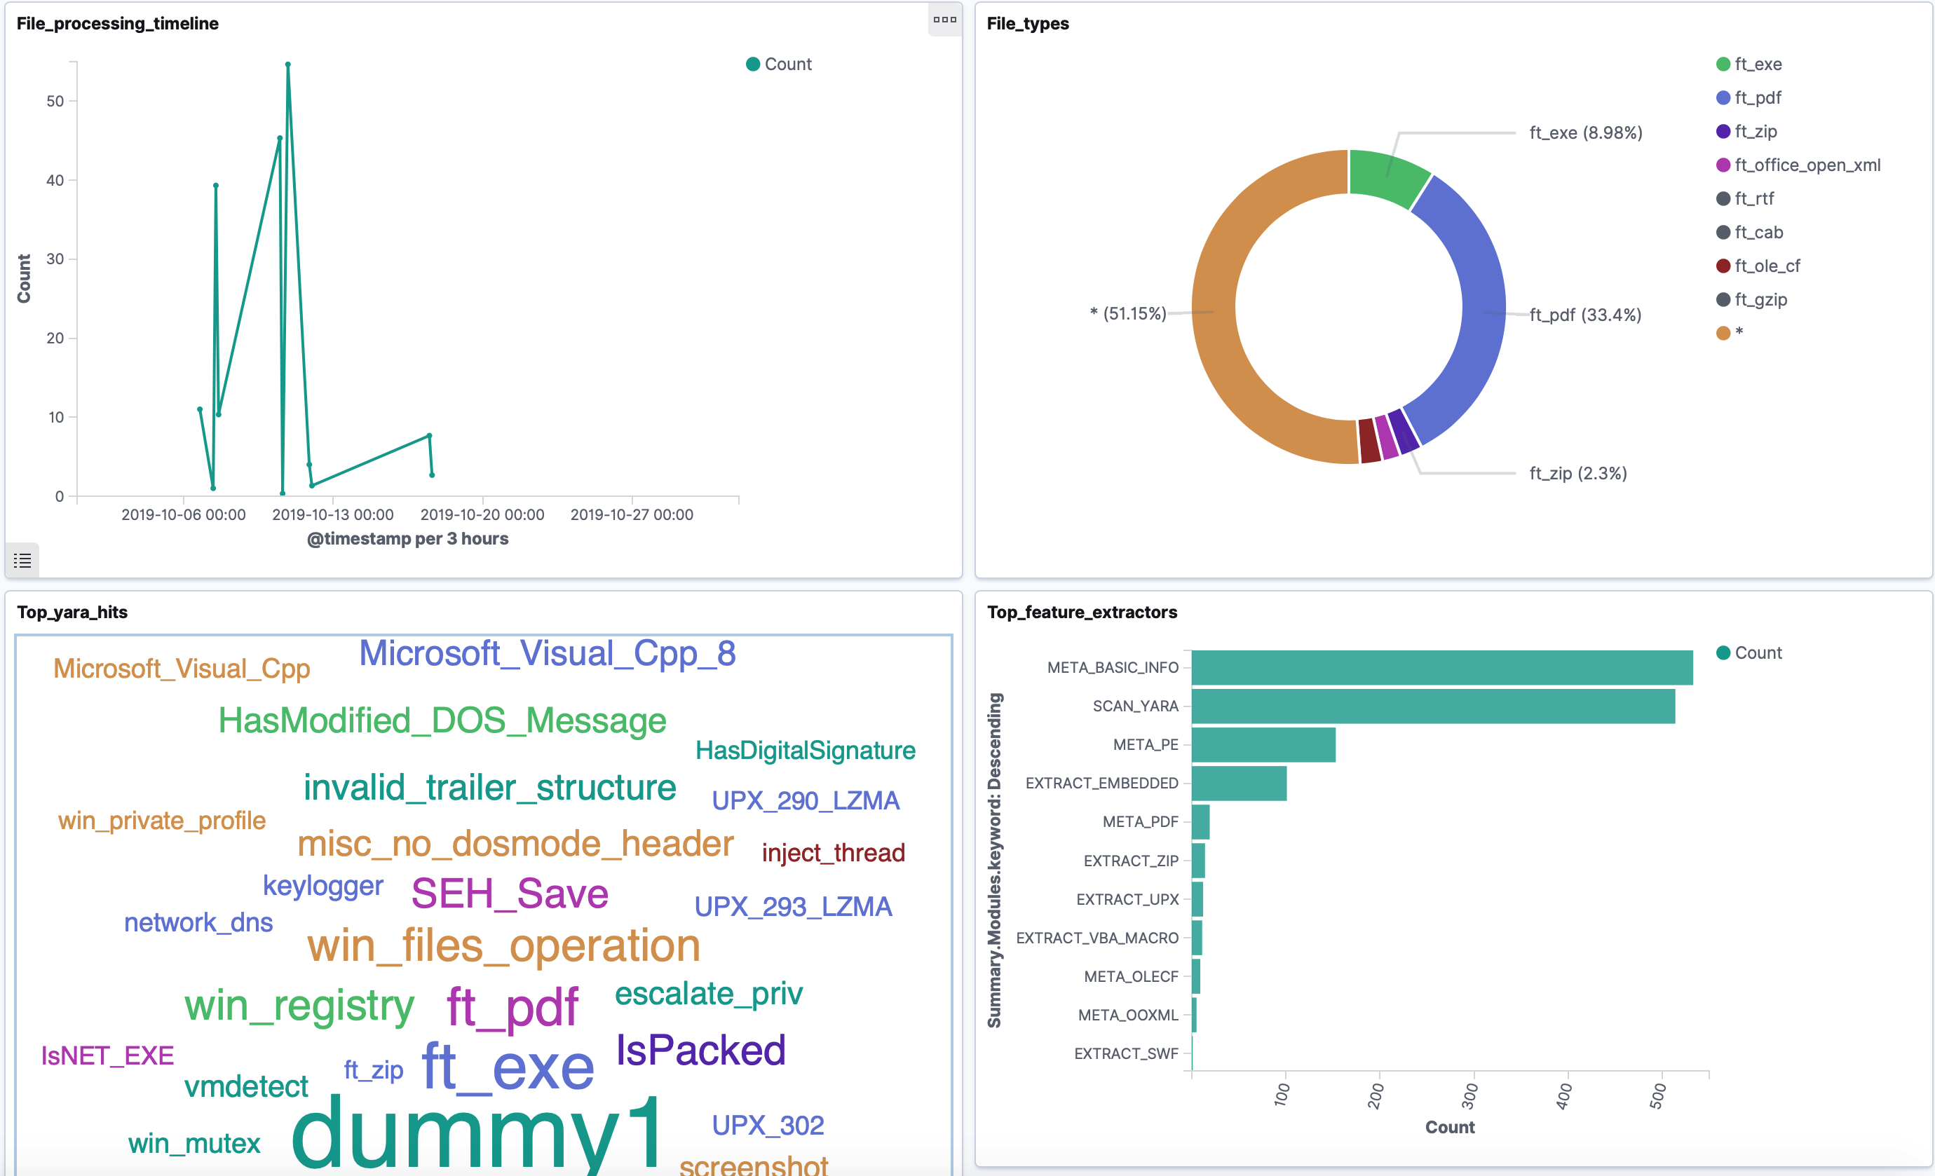

Slide 43
Next Steps….
Building Alerts and heuristics for threat detection.
Using Machine learning capabilities of CSP for advance analysis and clustering.
Infrastructure-As-a-Code (Terraform, CloudFormation)

Slide 44
Future Improvements
Integrating Cuckoo sandbox for dynamic feature collection.
Building a front-end UI that can receive files and show status of processing.
Additional intelligence Integration like threat feeds, custom BL/WL

Slide 45
Feedback
https://bit.ly/35zvdB1

Slide 46
Thankyou!! Köszönöm!!

